Slide 1

Restaurant Operations Analysis Using MySQL

Slide 2

Project Objective
Data-Driven Analysis
The objective of this project is to analyze restaurant operations by examining ordering patterns, menu insights, and customer preferences using structured query language (SQL).
Operational Insights
This data-driven approach helps to uncover trends in customer behavior, menu performance, and operational efficiency.

Slide 3

How This Analysis Helps the Client
Menu Optimization
Identifying best and worst-performing dishes by popularity and profitability.
Operational Efficiency
Recognizing peak order volumes and large order patterns to optimize staffing and preparation.
Customer Preferences
Understanding what items or categories are most popular, and tailoring promotions accordingly.
Revenue Insights
Analyzing top-spending orders to explore upselling opportunities.
This analysis provides actionable insights that support data-informed decision-making in several key areas:

Slide 4
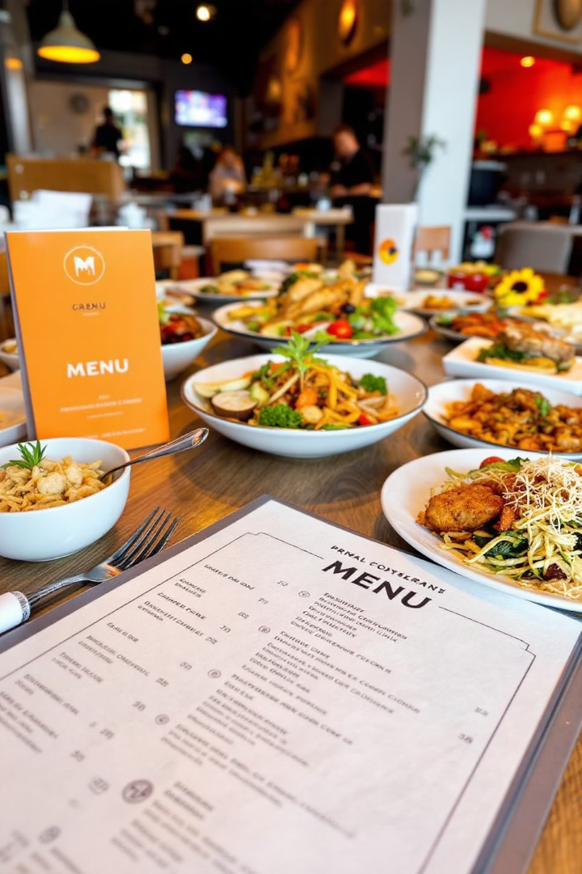




Section 1: Menu Analysis
Menu Overview
What are the items on the menu? How many items are on the menu?
Price Analysis
What are the least and most expensive items?
Italian Cuisine Focus
How many Italian dishes are on the menu? What are the least and most expensive Italian dishes?
Category Breakdown
How many dishes are in each category? What is the average dish price within each category?

Slide 5
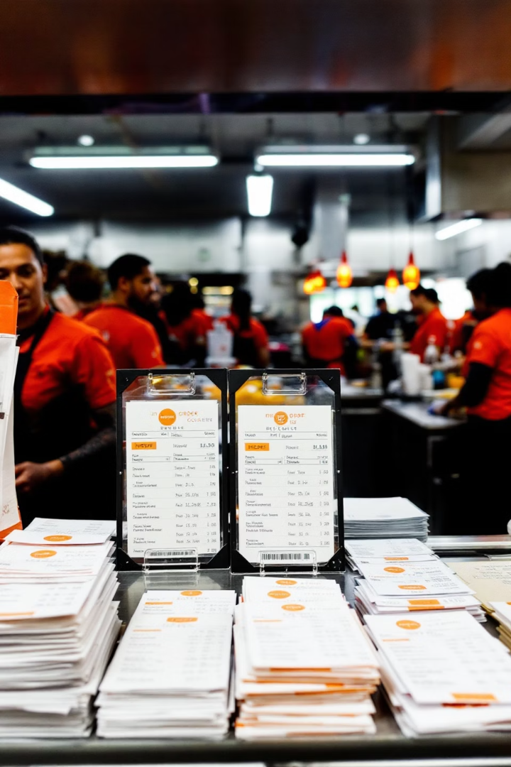




Section 2: Order Data Analysis
Date Range
Total Orders
Items Ordered
What is the date range of the order data?
How many total orders were made within this date range?
How many items were ordered in total?
Large Orders
Which orders had the most number of items? How many orders had more than 12 items?

Slide 6
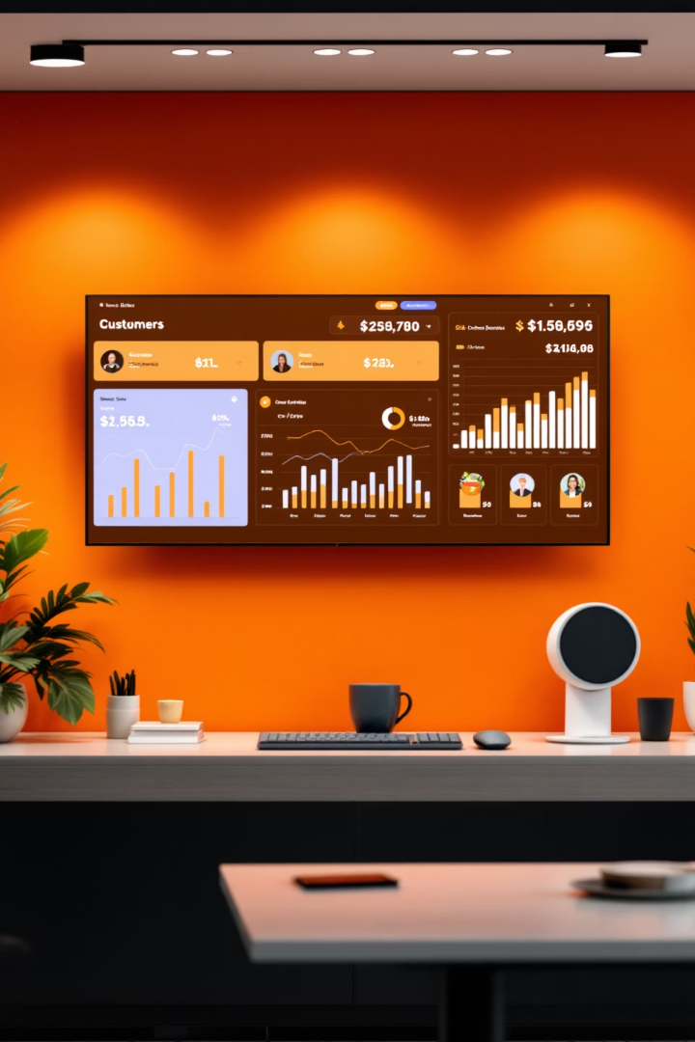
Section 3: Sales & Customer Insights
1
Popular Items
Which items were ordered the most and least, and which categories do they belong to?
2
Top Spending Orders
What were the top 5 highest-spending orders?
3
Highest-Spend Analysis
What details and insights can we gather from the highest-spend order?
4
Top 5 Insights
What are the details and insights from the top 5 highest-spending orders?

Slide 7
Overall Conclusions
Key Takeaways
Strategic Insights
This analysis provides a comprehensive view of menu performance and customer behavior. Key takeaways include:
Customer diversity in ordering behavior suggests the potential for bundled promotions across cuisines.
Order patterns show consistent high-volume activity, useful for optimizing kitchen operations and staffing.
Italian dishes are priced higher and appear frequently in top orders, validating premium pricing.
American comfort items drive volume, while Asian dishes contribute to high-value orders.

Slide 8

Implementation Benefits
Strategic Pricing
Targeted Marketing
and develop pricing strategies that align with customer behavior—leading to better profitability and customer satisfaction.
Menu Refinement
target marketing more effectively
By using these insights, the café can refine its menu

Slide 9

Thank You
Project by: Dharmesh Parmar
Email: Dhparmar@gmail.com

